Slide 1
Data Mining
Ch 8/9: Classification – 4
Rule-based classification
Accuracy of Classification
Wan D. Bae, Ph.D.
baewd@hanyang.ac.kr

Slide 2
Overview
Classification: basic concepts
Classification methods:
  Decision tree induction
  Bayesian classification methods
  Neural networks
  Rule-based classification (Ch 8.4)
    A model is represented as a set of If-Then rules
Accuracy of Classification (Ch 8.5)

Slide 3
Using IF-THEN Rules for Classification
Represent the knowledge in the form of IF-THEN rules
  IF condition, THEN conclusion
  R: IF age = youth AND student = yes THEN buys_computer = yes
Assessment of a rule: coverage and accuracy
  n_{covers} = # of tuples covered by R
  n_{correct} = # of tuples correctly classified by R
  coverage(R) = n_{covers} /|D| /* D: training data set */
  accuracy(R) = n_{correct} / n_{covers}
If more than one rule are triggered, need conflict resolution
  Size ordering: assign the highest priority to the triggering rules that has the “toughest” requirement (i.e., with the most attribute tests)
  Class-based ordering: decreasing order of prevalence or misclassification cost per class
  Rule-based ordering (decision list): rules are organized into one long priority list, according to some measure of rule quality or by experts

Slide 4
Rule Extraction from a Decision Tree
Example: Rule extraction from our buys_computer decision-tree
IF (Rule antecedent) → THEN (precondition)
  IF age = young AND student = no, THEN buys_computer = no
  IF age = young AND student = yes, THEN buys_computer = yes
  IF age = mid-age, THEN buys_computer = yes
  IF age = old AND credit_rating = excellent, THEN buys_computer = no
  IF age = old AND credit_rating = fair, THEN buys_computer = yes
age?
<=30
31..40
>40
student?
credit rating?
yes
no
yes
excellent
fair
no
yes
no
yes

Slide 5
Rule Induction: Sequential Covering Method
Sequential covering algorithm:
  Extracts rules directly from training data
  Rules are learned sequentially, each for a given class C_{i} will cover many tuples of C_{i} but none (or few) of the tuples of other classes
Steps:
  Rules are learned one at a time
  Each time a rule is learned, the tuples covered by the rules are removed
  Repeat the process on the remaining tuples until termination condition
  Termination condition:
    e.g., when no more training examples or
    when the quality of a rule returned is below a user-specified threshold

Slide 6
Sequential Covering Algorithm
For each class Ci
while (enough target tuples left)
  generate a rule
  remove positive target tuples satisfying this rule
Examples covered
by Rule 2
Examples covered
by Rule 1
Examples covered
by Rule 3
Positive examples
In machine learning, positive tuples are the tuples of the class for which we are learning rules while negative tuples are remaining tuples that belong to other classes

Slide 7
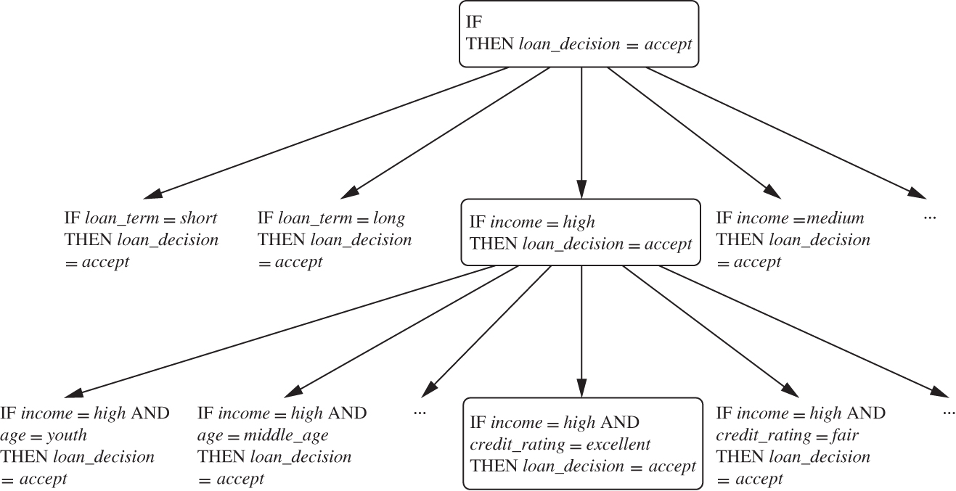
Sequential Covering Method: Example
A general-to-specific search through rule space

Slide 8

How to Learn-One-Rule?
Start with the most general rule possible: condition = { }
Each time adding a new attribute by adopting a greedy depth-first strategy
  Picks the one that most improves the rule quality
Foil-gain: assesses info_gain by extending condition
  pos (neg) is # of positive (negative) tuples covered by R
  pos’ (neg’) is # of positive (negative) tuples covered by R’

Slide 9
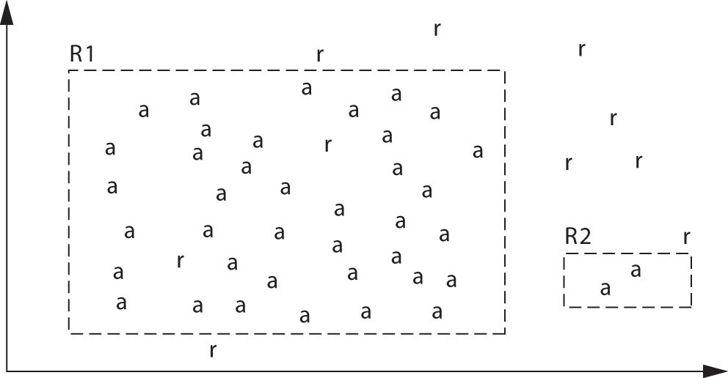
Rule Quality Measures
Rule-quality measures: consider both coverage and accuracy
Seek other measures for evaluating rule quality

Slide 10
Rule Generation
To generate a rule
  while(true)
  find the best predicate p
  if foil-gain(p) > threshold then add p to current rule
  else break
A3=1
A3=1&&A1=2
A3=1&&A1=2
&&A8=5
Positive examples
Negative examples
In machine learning, positive tuples are the tuples of the class for which we are learning rules while negative tuples are remaining tuples that belong to other classes

Slide 11
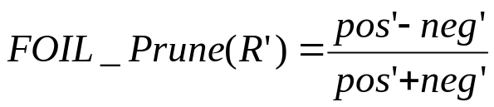

Rule Pruning
“Learn-One-Rule” does not employ a test set when evaluating rules.
  The assessments are made with tuples form the training set
  Hence the rules may perform well on the training data, but less well on subsequent data
Rule pruning based on an independent set of test tuples
  Choose to prune a rule R, if the pruned version of R has greater quality
FOIL:
  If FOIL_Prune is higher for R’ (the pruned version of R), then prune R
  >
  prune R!

Slide 12
Classification Assessment: Example
Consider a training set that contains 100 positive examples and 400 negative examples.
For each of the following candidate rules,
  R1 : A -> + (covers 4 positive and 1 negative examples),
  R2 : B -> + (covers 30 positive and 10 negative examples),
  R3 : C -> + (covers 100 positive and 90 negative examples),
Determine which is the best and worst candidate rule according to:
(1) Rule accuracy
(2) Rule coverage
(3) FOIL’s information gain

Slide 13
Linear Classification
Binary Classification problem
  The data above the red line belongs to class ‘x’
  The data below red line belongs to class ‘o’
Examples:
  Support Vector Machine, Perceptron, Probabilistic Classifiers
x
x
x
x
x
x
x
x
x
o
o
x
o
o
o
o
o
o
o
o
o
o
o
Notes:
SVM: Support Vector Machines

Slide 14
Model Evaluation and Selection
Evaluation metrics: How can we measure accuracy?
Use validation test set of class-labeled tuples instead of training set when assessing accuracy
Methods for estimating a classifier’s accuracy:
  Holdout method, random subsampling
  Cross-validation
  Bootstrap
Comparing classifiers: (After midterm exam)
  Confidence intervals
  Cost-benefit analysis and ROC Curves

Slide 15
Classifier Evaluation Metrics: Confusion Matrix
Confusion Matrix:
Actual class\Predicted class | C₁ | ¬ C₁
C₁ | True Positives (TP) | False Negatives (FN)
¬ C₁ | False Positives (FP) | True Negatives (TN)
Example of Confusion Matrix:
Actual class\Predicted class | buy_computer = yes | buy_computer = no | Total
buy_computer = yes | 6954 | 46 | 7000
buy_computer = no | 412 | 2588 | 3000
Total | 7366 | 2634 | 10000
Given m classes, an entry, CM_{i,j} in a confusion matrix indicates
# of tuples in class i that were labeled by the classifier as class j
May have extra rows/columns to provide totals

Slide 16
Classifier Evaluation Metrics
A\P | C | ¬C
C | TP | FN | P
¬C | FP | TN | N
 | P’ | N’ | All
Class Imbalance Problem:
  One class may be rare, e.g. fraud, or HIV-positive
  Significant majority of the negative class and minority of the positive class
  Sensitivity: True positive recognition rate
    Sensitivity = TP/P
  Specificity: True negative recognition rate
    Specificity = TN/N
accuracy (recognition rate): percentage of test set tuples that are correctly classified
Accuracy = (TP + TN)/(P+N)
Error rate:
1 – Accuracy or
Error rate = (FP + FN)/(P+N)

Slide 17




Classifier Evaluation Metrics
Precision: exactness – what % of tuples that the classifier labeled as positive are actually positive
Recall: completeness – what % of positive tuples did the classifier label as positive?
  Perfect score is 1.0
  Inverse relationship between precision & recall
F measure (F₁ or F-score): harmonic mean of precision and recall,
F_{ß}: weighted measure of precision and recall
  assigns ß times as much weight to recall as to precision

Slide 18
Classifier Evaluation Metrics: Example
Actual Class\Predicted class | cancer = yes | cancer = no | Total | Recognition(%)
cancer = yes | 90 | 210 | 300 | 30.00 (sensitivity
cancer = no | 140 | 9560 | 9700 | 98.56 (specificity)
Total | 230 | 9770 | 10000 | 96.40 (accuracy)
  Precision = 90/230 = 39.13%
  Recall = 90/300 = 30.00%

Slide 19
Classification Accuracy: Estimating Error Rates
Partition: Training-and-testing (Hold-out method)
  use two independent data sets, e.g., training set (2/3), test set(1/3)
  used for data set with large number of samples
Cross-validation:
  divide the initial data set into k partitions (folds)
  k-fold cross-validation:
    Training and testing is performed k times
    Use k-1 partitions as training data and one partition as test data
  The accuracy estimate is the overall number of correct classifications divided by the total number of tuples in the initial data
  Stratified cross-validation: data in folds follow the same distribution of the initial data
  Stratified 10-fold cross validation is recommended

Slide 20

Classification Accuracy: Bootstrap
Bootstrap
  Works well with small data sets
  Samples the given training tuples uniformly with replacement
    i.e., each time a tuple is selected, it is equally likely to be selected again and re-added to the training set
Several bootstrap methods, and a common one is .632 boostrap
  A data set with d tuples is sampled d times, with replacement, resulting in a training set of d samples.
  The data tuples that did not make it into the training set end up forming the test set.
  About 63.2% of the original data end up in the bootstrap, and the remaining 36.8% form the test set (since (1 – 1/d)^{d} ≈ e⁻¹ = 0.368)
  Repeat the sampling procedure k times, overall accuracy of the model:

Slide 21
Increasing the Accuracy: Bagging and Boosting
General idea
Training data
Altered Training data
Altered Training data
……..
……..
Aggregation
Classification method (CM)
Classifier C
predicts or votes
CM
Classifier C1
predicts or votes
CM
Classifier C2
predicts or votes
Classifier C*
Counts
all predicts or votes

Slide 22
Bagging
Given a set D of d tuples
Generate a bootstrap sample T from D. Cases in D may not appear in T or may appear more than once.
Repeat this sampling procedure k times, getting a sequence of k independent training sets
A corresponding sequence of classifiers C1, C2, …, Ck is constructed for each of these training sets, by using the same classification algorithm
To classify an unknown sample X, let each classifier predict or vote
The Bagged Classifier C* counts the votes and assigns X to the class with the “most” votes

Slide 23
Boosting Technique — Algorithm
Assign every training tuple an equal weight 1/N
For t = 1, 2, …, k, do
  Obtain a hypothesis (classifier) h^{(t)} under w^{(t)}
  Calculate the error rate of h(t) and re-weight the tuples based on the error
  Samples that are incorrectly predicted are weighted more heavily to “pay more attention” to them by h^{(t+1)}
  Each classifier is dependent on the previous ones
Output a weighted sum of all the hypothesis h*, with each hypothesis weighted according to its accuracy on the training set

